Slide 1
Notes:
Thank you for giving me the opportunity to talk to you about Multiply Online, what we believe is a unique product that can help you reach and retain new learners.

Slide 2
Notes:
The WEA is a Charity that is dedicated to bringing Adult learning within reach whatever your circumstances: That can be in numerous ways:
For someone who has had a poor previous experience of education likely at school we have staff trained to get alongside learners and support them in revealing hidden strengths that can help transform lives.
By using trusted community venues in some of the most deprived areas of England and Scotland we reach learners where they are.
We use our Charitable Purpose to fund learners where others will not

Slide 3
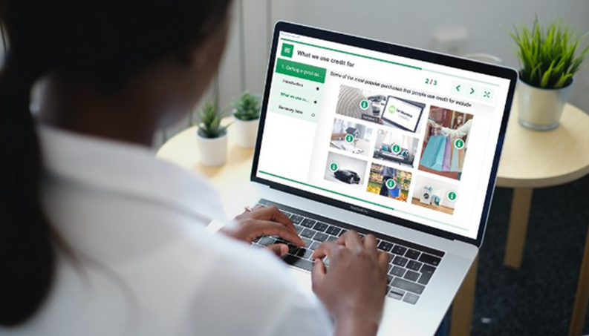
Alignment with Multiply
Using DFE’s prospectus alongside intelligence gathered from HOLEX and conversations with commissioners and colleagues we wanted to design and develop a program that learners could access at a time that suits them supported by an online community.
To increase engagement in Numeracy and to create a supply of learners into accredited functional skills.
3
Notes:
And so to Multiply Online where we bring together the flexibility of asynchronous learning on Mobile, Tablet or PC for those who

Slide 4
Ambition
To create programs that could be embedded across our existing provision with consistent quality and to add value to our existing learners’ experience in a financially astute way.
To deliver a framework for the curriculum moving forward by providing good quality asynchronous learning opportunities and developing an online community of learning using the numeracy learning champions model
4

Slide 5
Programme Content
Starting point were the themes identified for the project. Then linked numeracy subject content to the badge themes
Used to facilitate progression as per subject coverage, confidence and possible APEL or shorter intensive courses as set out in government guidance
5

Slide 6
6

Slide 7
Learner-centred curriculum design and delivery
The way teaching is delivered comes in a variety of forms.
There are various approaches to delivery which aim to support learners through their journey so they can achieve maximum success.
Employing effective approaches enables learners to reach their full potential and provides a strong foundation for learning.
This also helps learners realise their own capabilities which improves their self-confidence and self-esteem. In turn, this increases the likelihood of learners achieving, as they will be more motivated to participate in different activities.
7

Slide 8
Blended Learning
Evidence proves that a blended approach of synchronous and asynchronous learning is most productive we do this through interactive activities, structured input and a numeracy coach.
8

Slide 9
Multiply Incorporates a variety of different eLearning activities
We know that active rather than passive learning is effective.
Self-guided learners need a variety of different activities to cater to their individual learning styles, preventing boredom, thereby boosting engagement and learner participation.
Multiply online includes: video presentations, audio narratives, varied question styles and interactive activities along with text-based pages.
9

Slide 10
Multiply uses real world examples to boost motivation
One of the main challenges of designing an asynchronous eLearning course is creating a connection with your learners. They may feel isolated from the eLearning community, which hinders them from actively participating. This is why it’s important to integrate real world examples, that tie into the subject matter.
Multiply shows how learners can use numeracy in their real lives, which specific skills they are developing, as well as how each particular piece of new knowledge is going to improve their lives.
10

Slide 11
Intrinsic motivation
While external rewards may be a great motivator, it’s the intrinsic motivation that truly counts. Typically, learners who are intrinsically motivated fare better in self-guided eLearning courses than those who rely on extrinsic motivation. .
The Multiply themes were guided by the most popular topics searched for at the moment and aims to tap into what learners feel is most important in their lives today.
11

Slide 12
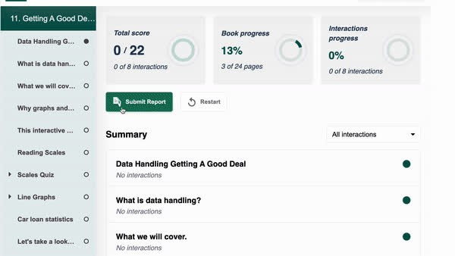
Effective assessment and evidence of impact
Assessment
No learning experience is complete without an effective assessment strategy, and this is doubly important for asynchronous e-Learning courses.
Multiply integrates quizzes and activities to test learners’ knowledge and check their progress without it feeling like a test or examination.
Doing so also gives learners the chance to gauge their progress, so that they can improve upon their weaknesses along with building confidence in attempting to answer questions without a fear of failing.
12

Slide 13
Flexible and accessible delivery and support
Give them a helping virtual hand
Even learners who are working autonomously need support.
They may encounter technical problems that prevent them from progressing in the eLearning course, or they may need help, to understand a more complex idea or concept.
Whatever the case may be, numeracy coaches provide access to reliable support via messaging, drop-ins and one-to-one online help via Teams or Zoom if required.
13

Slide 14
Convenience
Chances are learners aren’t going to be willing or able to sit through an hour-long eLearning session. This is why Multiply is broken down into smaller bite-size modules and individual pages that are easily digestible and can be completed when convenient.
Many learners need to complete courses around work and family commitments
14

Slide 15
Cross-curricular learning
Cross-curricular learning is a way to combine different subjects to deliver a curriculum that learners find engaging and enjoyable.
It offers a way for learners to develop their knowledge, skills and understanding and become motivated to learn through a series of interconnected topics. For tutors, cross-curricular learning presents the opportunity to combine learning aims from different courses into one.
Planning for and implementing cross-curricular instruction may seem like a daunting task. The Multiply online course does this in relation to the badge themes but has been designed with materials to support tutors who wish to embed numeracy within their existing courses or allow learners to study the online modules alongside another course.
15

Slide 16
Mastery Approach to Securing Knowledge
Underpinning Principles
Mathematics teaching for mastery assumes everyone can learn and enjoy mathematics. Multiply has been designed to reach as many people as possible from Entry 1 to Level 2.
Curriculum design ensures a coherent and detailed sequence of essential content to support sustained progression over time.
When designing the Multiply modules each content statement was reviewed and built with Learning and Progression Steps in mind. Learning and Progression Steps are designed to scaffold the learning required in order to meet the future expectations of the Functional Skills National Curriculum.
These key pieces of learning will support learners in numeracy fluency. Learning and Progression Steps (LAPS) are smaller, progressive steps which support learning towards the Key Learning in numeracy expectations.
16

Slide 17
Lesson design
Lesson design links to prior learning to ensure all can access the new learning and identifies carefully sequenced steps in progression to build secure understanding. Modules are ordered to build upon one another
Examples, representations and models are carefully selected to expose the structure of mathematical concepts and emphasise connections. The models and representations used vary to include things such as concrete, pictorial and abstract representations and different ways to perceive ideas e.g. bar charts and part- whole models
Multiply is a step into numeracy, not all topics are covered, nor in depth with many assessments the idea of multiply is to give learners a step onto accredited maths courses where more practise and embedding will be achieved but multiply will serve to enable them to feel ready to face the challenges of an accredited qualification
17

Slide 18
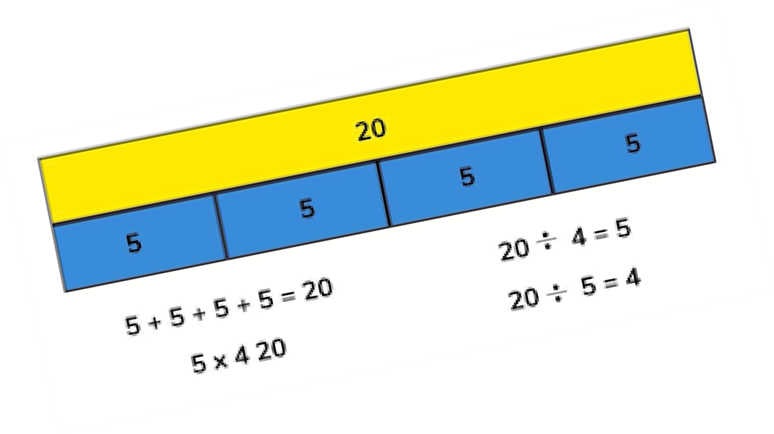
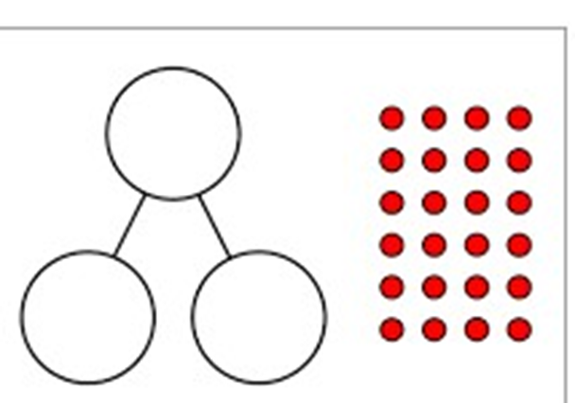
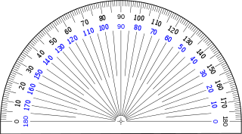
In the classroom
In a typical lesson, the tutor leads back and forth interaction, including questioning, short tasks, explanation, demonstration, and discussion, enabling learners to think, reason and apply their knowledge to solve problems. Multiply has incorporated short bursts of input with activities to try and incorporate this where possible in an asynchronous course.
This Photo by Unknown Author is licensed under CC BY-SA
18

Slide 19
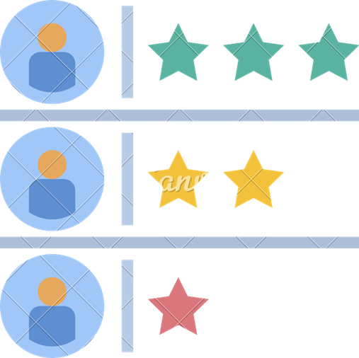
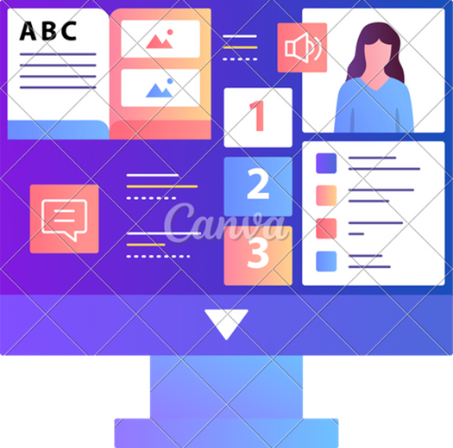
Multiply technical
Initial Assessment
Once enrolled in the Multiply course on our VLE, learners can complete the initial assessment right away to determine the appropriate level for them, and begin their learning without any delays.
Course Structure
To ensure a structured approach to learning, learners must complete the pre-requisites before moving on to the subsequent modules. This ensures that all learners follow the Multiply course in a structured manner and acquire the necessary knowledge and skills before progressing to the next level.
19

Slide 20
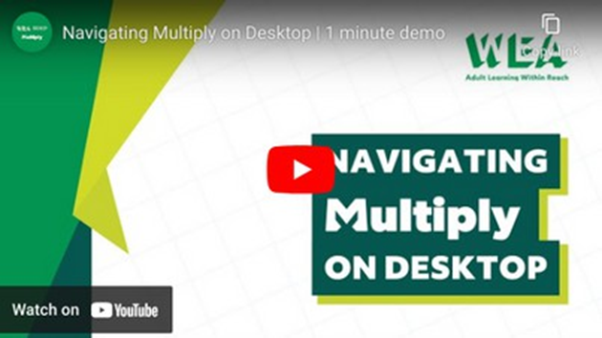
Videos
To provide a seamless learning experience for our face-to-face learners, we've created the WEA Multiply Youtube channel where they can access all the video content from the Canvas course. This additional resource ensures that all learners have access to the same course materials and can benefit from a blended learning experience.
Asynchronous Support
To provide a visual and contemporary approach to assist learners in accessing the Canvas course, we have developed navigation videos, along with PDF guides. Based on feedback from the initial group of learners, we plan to create additional resources to further enhance the learning experience and ensure a seamless experience.
20

Slide 21
Canvas Analytics
Our learners' data provides invaluable insights into their individual interactions with the course. By analysing this data, we can identify which parts of the course they find most engaging and use this information to enhance the learning experience by incorporating more of what they enjoy.
Accessible on All Devices
Whether you're on-the-go or at your desk, the Multiply course has been designed to be fully accessible on both desktop and mobile devices with Canvas and the Canvas app. This ensures that learners can learn wherever and whenever they want, without compromising on the quality of their learning experience.
21

Slide 22
Why WEA Multiply Online?
Aligns with Functional Skills Curriculum and can ready learners for functional skills programmes.
Provides a learner-centred curriculum with flexibility to embed cross-curricular.
Offers effective assessment and evidence of progress.
Offers flexible and accessible delivery and support.
Encompasses a mastery approach where possible to enhance embedding of skills and knowledge.
Provides analytics data
The online programme is ready-built for your learners and can be delivered within weeks.
22

Slide 23
Questions & Next Steps
WEA can be responsive to need, we can deliver small- or large-scale programs independently or in partnership with existing provision.
Capacity is available in all areas with differing degrees of mobilisation speed.
Speak to our Partnership Manager about your specific needs

