Slide 1
The ripple effect of adult learning
Notes:
Welcome [tailor to event]

Slide 2
Notes:
Today, I’m going to tell you a little bit about:
Who we are
Why we do what we do
How we do it
And, I’m going to share the impact we have on our learners – and its our learners that matter most
Let me tell you a little more about how we make such impact – what is special about the WEA…
Let’s start at the beginning. The WEA is the leading adult education charity in the UK.
We serve over 30 thousand learners each year. We empower those adults by bringing great teaching to communities across England and Scotland.
We do this by working closely with community organisers and learners, so we can understand and respond to their needs.
For 120 years we have been driven by the mission to bring adult education within reach of everyone who needs it, fighting inequality and promoting social justice. Today we focus on three areas, learning for life, learning for work and learning that builds communities. This is what we call the ripple effect of adult education:
Starting with the learner, their home life and families
Moving on to help them get a job and progress at work
Then helping them to connect, integrate and support their local communities.

Slide 3
Notes:
The WEA provides a unique, supportive, tailored learning experience for its students, responsive to their needs and interests.
A critical part of this experience are our expert professional tutors, who make this possible.
We ensure study groups are small, allowing our tutors to tailor the way they teach learner and engage each group – be that online or face-to-face.
The small group environment also encourages learner-to-learner support, discussion and debate – essential to developing and embedding understanding.
Often our tutor groups also become friends for life! A real added bonus.
Our learners tell us that they felt overwhelmed and out of place with other providers – with us they feel safe, encouraged, supported and able to contribute.
But let’s now look at each of our ‘ripples’ in turn, starting with learning for life…

Slide 4
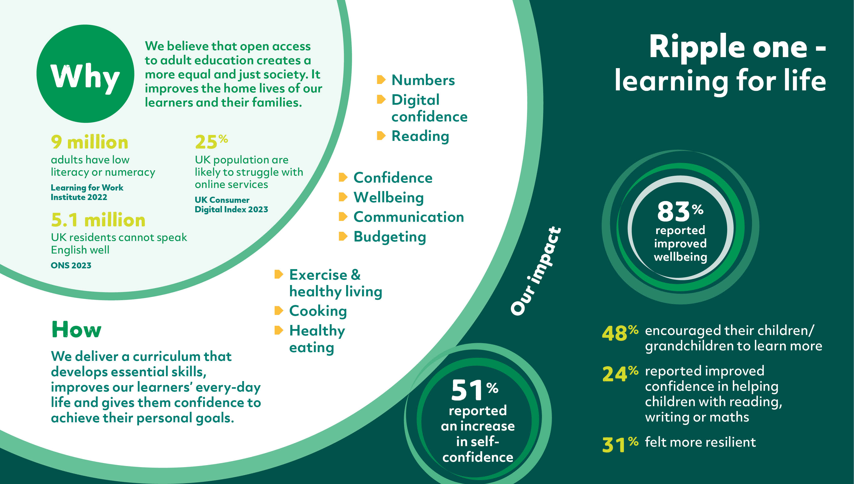
Notes:
It’s only right that we start at the epicentre – the individual – our learner and how we can support them to have a better life, with essential skills.
We are here to improve the home lives of our learners and their families.
So many millions in the UK struggle without the essentials – literacy, numeracy, day-to-day English, digital skills.
We are here to solve that, as well as develop confidence, healthy living and wellbeing, also rare commodities in the deprived communities we serve.
Over 80% of our learner report improved wellbeing after studying with us, with over half saying they have vital improvements in self-confidence and resilience
Our learners can then help their children and grandchildren to develop these core skills.

Slide 5
Notes:
I’d like you to meet Oksana.
Oksana fled the war in Ukraine, where she worked for the Government and was celebrated for doing good things for her community.
But when Oksana arrived she had little English.
Being the strong and determined person she is, she signed up for a WEA course, and got a volunteering role to practice with the language she was learning in class.
Soon she had the confidence to go for a job, similar to the one she did in Ukraine. As she says, she’s so pleased, she can now do what she can for her family, her refugee community, and her new home community of Worcester.

Slide 6
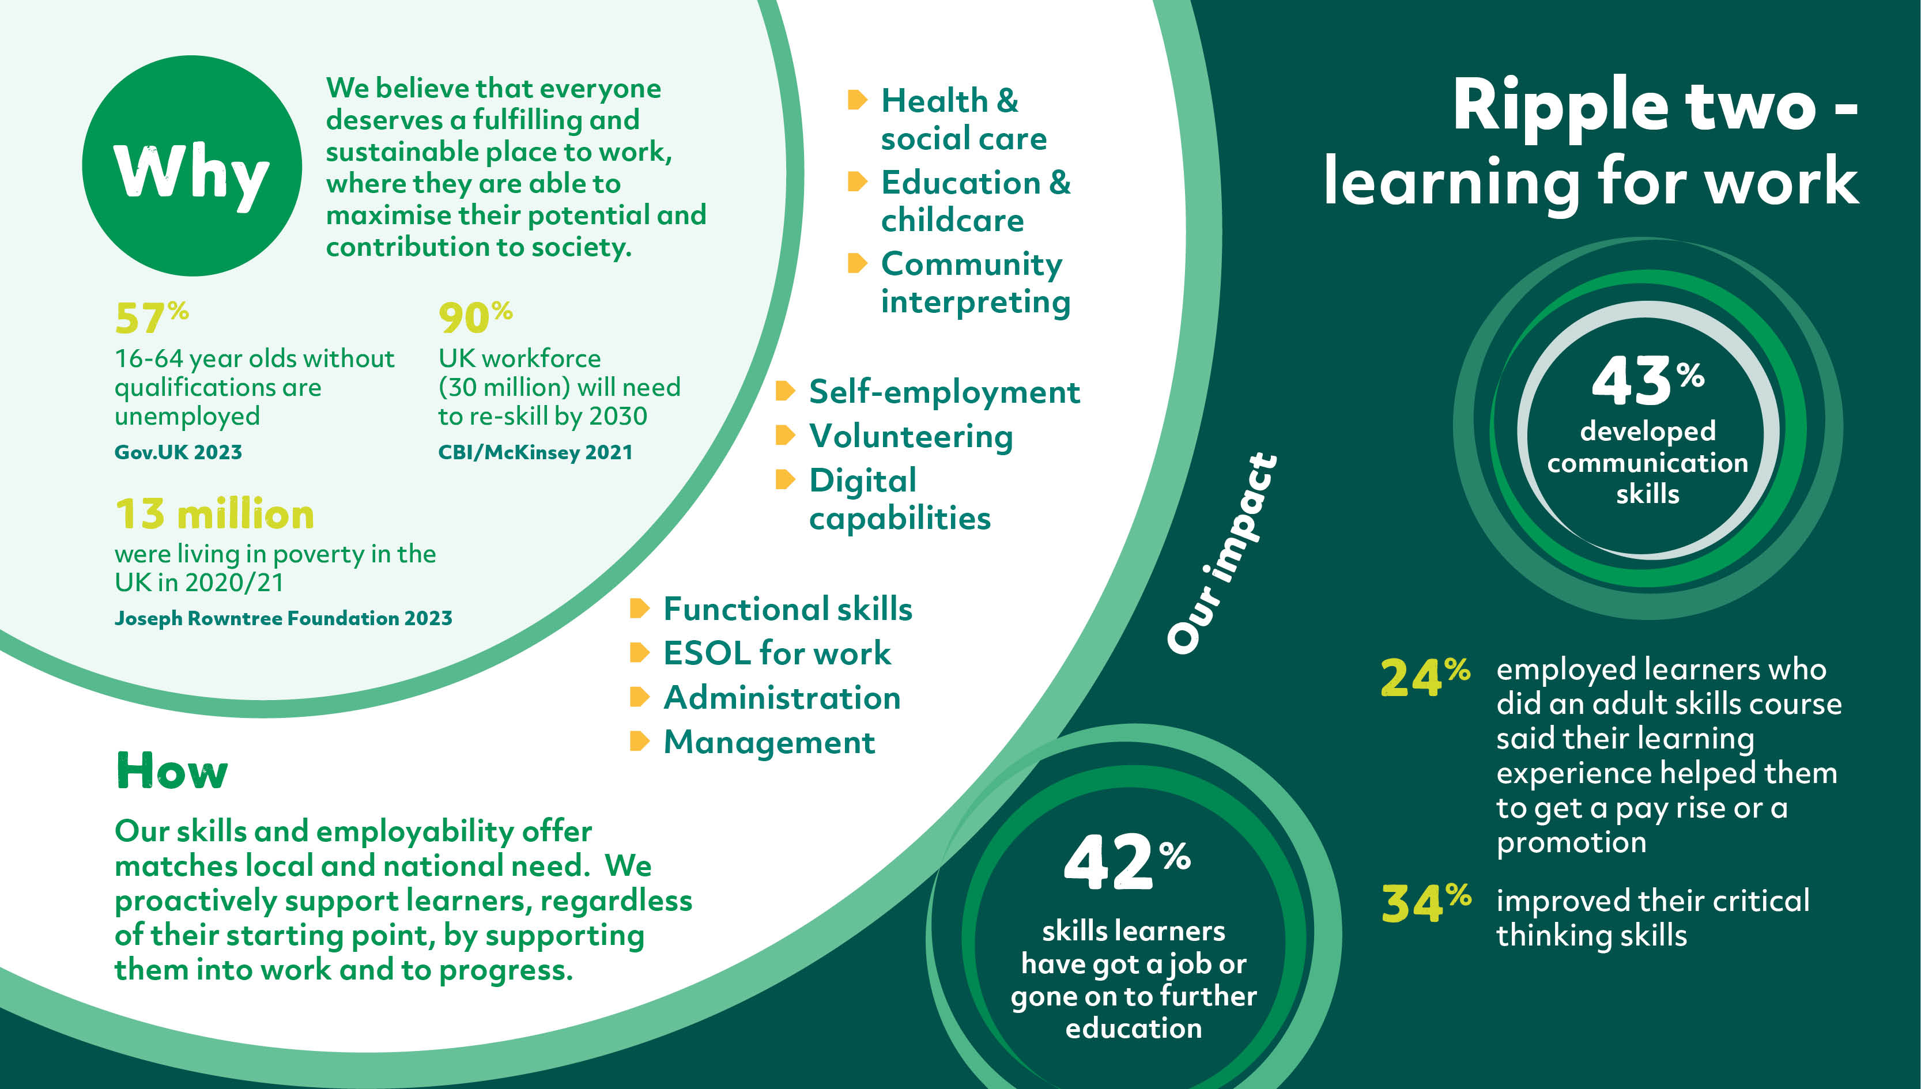
Notes:
Once we have supported those core skills, we also want our learners to be able to enjoy a fulfilling a job in a sustainable place of work.
We want them to maximise their potential and their contribution by work to society.
Our focus is in those areas of deprivation, and those who left school with little but knocks in confidence, or simply didn’t realise how important education was for their futures at the time.
57% of adults without qualifications are unemployed, and so many million are living in poverty, with the cost-of-living crisis deepening their woes.
We deliver a dynamic skills and employability offer, matched to local and national need, and continually shaped by working in partnership with employers and employer groups. Starting from a challenging base we are proud that 42% of the unemployed learners who study with us have got a job or gone on to further education. 43% develop critical communications skills – one of the five soft key skills identified by the CBI as missing within the workforce.
Our employed skills learners benefit too, with 24% saying they have got a pay rise or promotion as a result of their course.

Slide 7
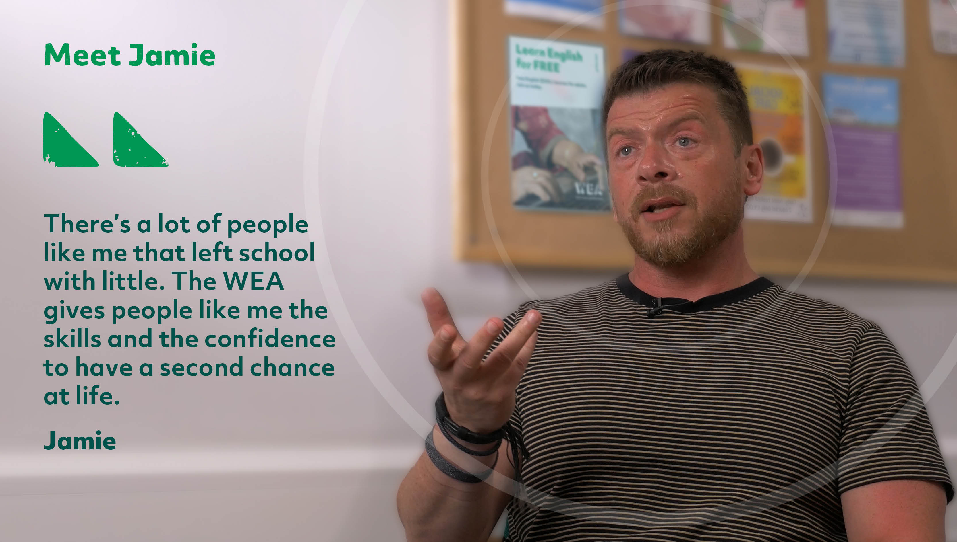
Notes:
Jamie is a great example of the learners we support.
Jamie was, in his own words, too cool for school. As a result he left school with no qualifications.
He did ok in work, even got on well, but never felt confident enough to build his skills through qualifications.
Colleagues at work encouraged him, and he’s done really well – applying all his skills for the community through his work – as he says – paying it back.

Slide 8
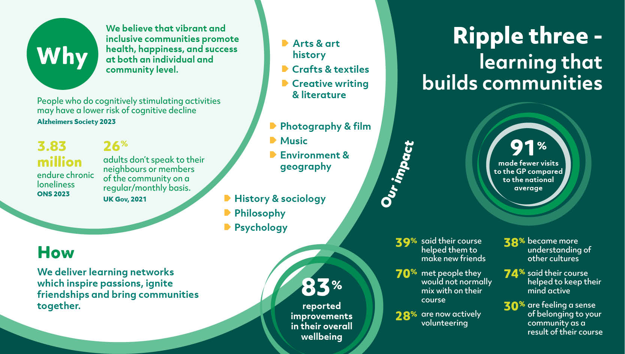
Notes:
Here’s the third and final part of our work – learning that builds communities.
We believe that vibrant and inclusive communities promote health, happiness, and success at both an individual and
community level.
WEA learning networks bring communities together.
We will design and deliver learning networks which inspire passions, ignite friendships and bring communities together.
We have to argue the case for this work – but the value of it is key
With an aging community that needs mental stimulation and personal connection to hold back the rise in dementia, how could we ignore this work.
With nearly four million enduring chronic loneliness and 26% never speaking to their neighbours, how can we ignore this work.
The benefit of 91% of our learners visiting the doctor less than the national average runs into millions. And I love to say that WEA learning is proven to be good for you!
But look at those community benefits. 70% of our learners get to know people they wouldn’t normally mix with, 38% became more understanding of other cultures, and 39% made new friends. It’s hard to put a fiscal value on the re-building of a caring and sharing society, but we know its important.

Slide 9
Notes:
Here’s Jayne. Jayne for me epitomises what we do and why we do it.
Jayne joined our classes to improve her skills, and to manage her mental health.
She’s loved it and blossomed, and now she brings groups within her community together, and she shares those skills.

Slide 10
Notes:
But, perhaps its best not to hear from me, but directly from some of our learners about the ripple effect – personal, work and community – on them.

Slide 11
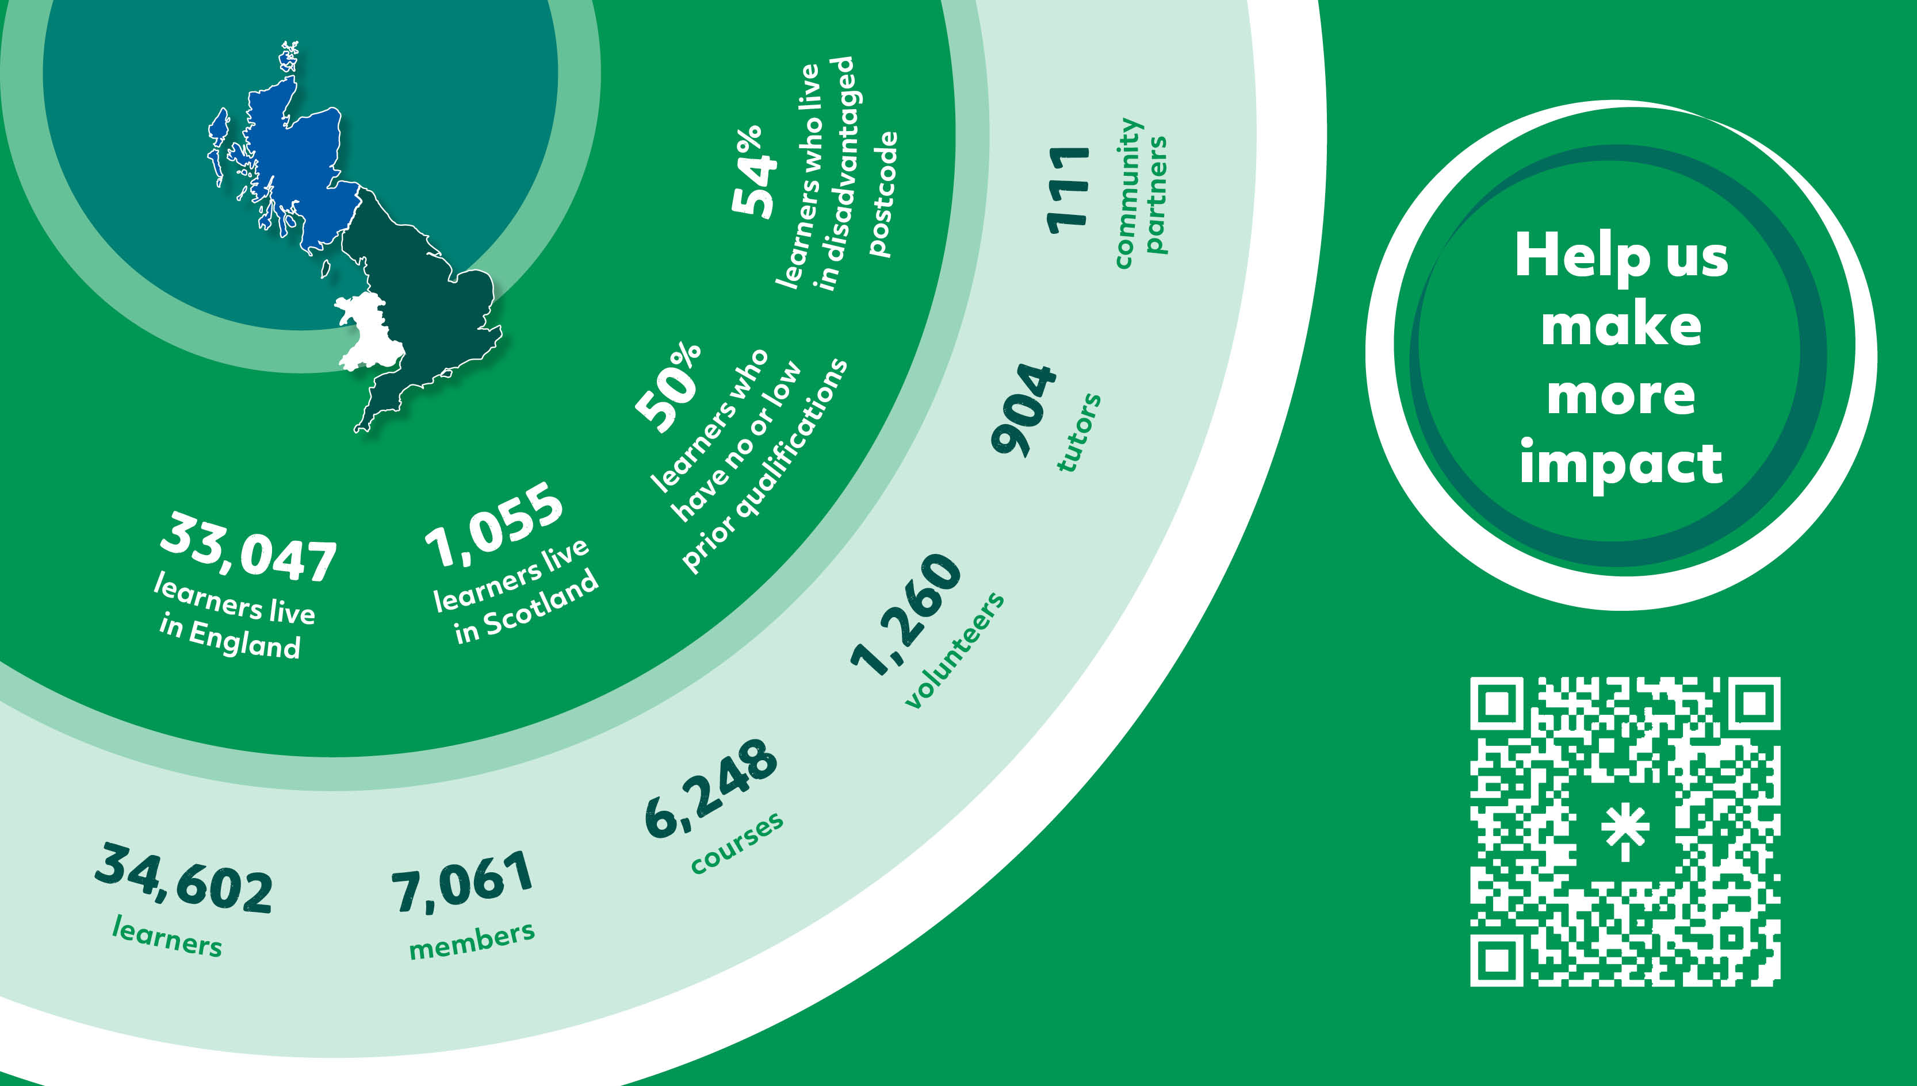
Notes:
Here are our vital statistics at a glance.
In 2022/23 we served over 34 thousand learners and seven thousand members, enriching their lives with over six thousand courses and 40 evening member lectures.
Our nine hundred tutors and thousand volunteers have helped, supported and inspired our learners with their subjects to achieve their goals.
We take those learners from the very basics, to reach their ambitions. Half of our learners have no or low prior qualifications and over half live in disadvantaged areas. We are reaching the people who need education most.

Slide 12
Notes:
If you believe in what we do, encourage local and national education policy to do these six things:
Create a national lifelong learning strategy: This would set out a holistic definition, looking through all three lenses (health, culture and work). It would set the roles and responsibilities and provide a framework for regional priorities.​
Return adult education funding to 2010 levels by 2029: Public finances are tight but support for adult learning would reap economic benefits in terms of productivity, as well as taking pressure off welfare benefits and also the NHS (through health and wellbeing outcomes). ​
Prioritise funding for those who left school with no or few qualifications: A lack of role models, aspiration and confidence can be tackled through community education. They provide important building blocks for Job Centres to work upon.​
Protect the freedom to set broad curriculum: Many adults are reluctant to return to learning and cultural education may be the only way to attract them back to study. Stop de-funding of “leisure learning”. Valuable mental health and wellbeing outcomes will also be lost. ​
Deliver a national campaign to drive up participation: Less than 30% of the adult population is currently learning. There is an urgent need to reach the remaining 70%. This includes some of the most disadvantaged groups in society and many who would benefit the most. ​
Support the post-19 education workforce: The WEA provides critical second chance education. It should not be doing it with less well-paid staff and struggling to recruit as a result.​

Slide 14
Notes:
Meet Jane.
When Jane’s partner died, Jane needed to make arrangements and get support for her mental health while she grieved. At every turn she was asked to log onto the web and complete forms. At one point she broke down and cried – she felt left behind.
Jane tried a course with another provider. She was over-whelmed and depressed.
Then someone recommended the WEA. Immediately she felt at ease in the classroom. Learning was fun and it all seemed so easy.
Now Jane can organise appointments, arrange to go out with friends. She is no-longer left behind.

Slide 15
Notes:
Meet Abdalazeez. When Abdalazeez moved to the UK from Syria, he wanted to find a job in healthcare following his earlier professional life as a nurse.
His time with the WEA gave him the language, the interview skills and the confidence to go for it and apply. Applying all he had learnt Abdalazeez got a job through his very first interview.
Now he’s able to work in the sector he loves and is looking into how to train to become a nurse in the UK.

Slide 16
Notes:
Meet Romeo. Romeo worked in healthcare until he had a workplace accident injuring his shoulder and making that role impossible for him.
Romeo felt lost and alone, until he did his WEA courses to improve his language skills and to become a Community Interpreter.
Now Romeo loves using his skills for work and to create and run the Ipswich Romanian Community organisation – connecting Romanians together and with the services and agencies they need for support.
He love doing what he can for his community, and we’re pleased to have helped him develop the skills to do so.

